Slide 1
What's up LOD Cloud Observing The State of Linked Open Data Cloud Metadata
Ahmad Assaf, Raphaël Troncy And Aline Senart
@ahmadaassaf
LDQ15 – 2nd Workshop on Linked Data Quality
1st June 2015

Slide 2
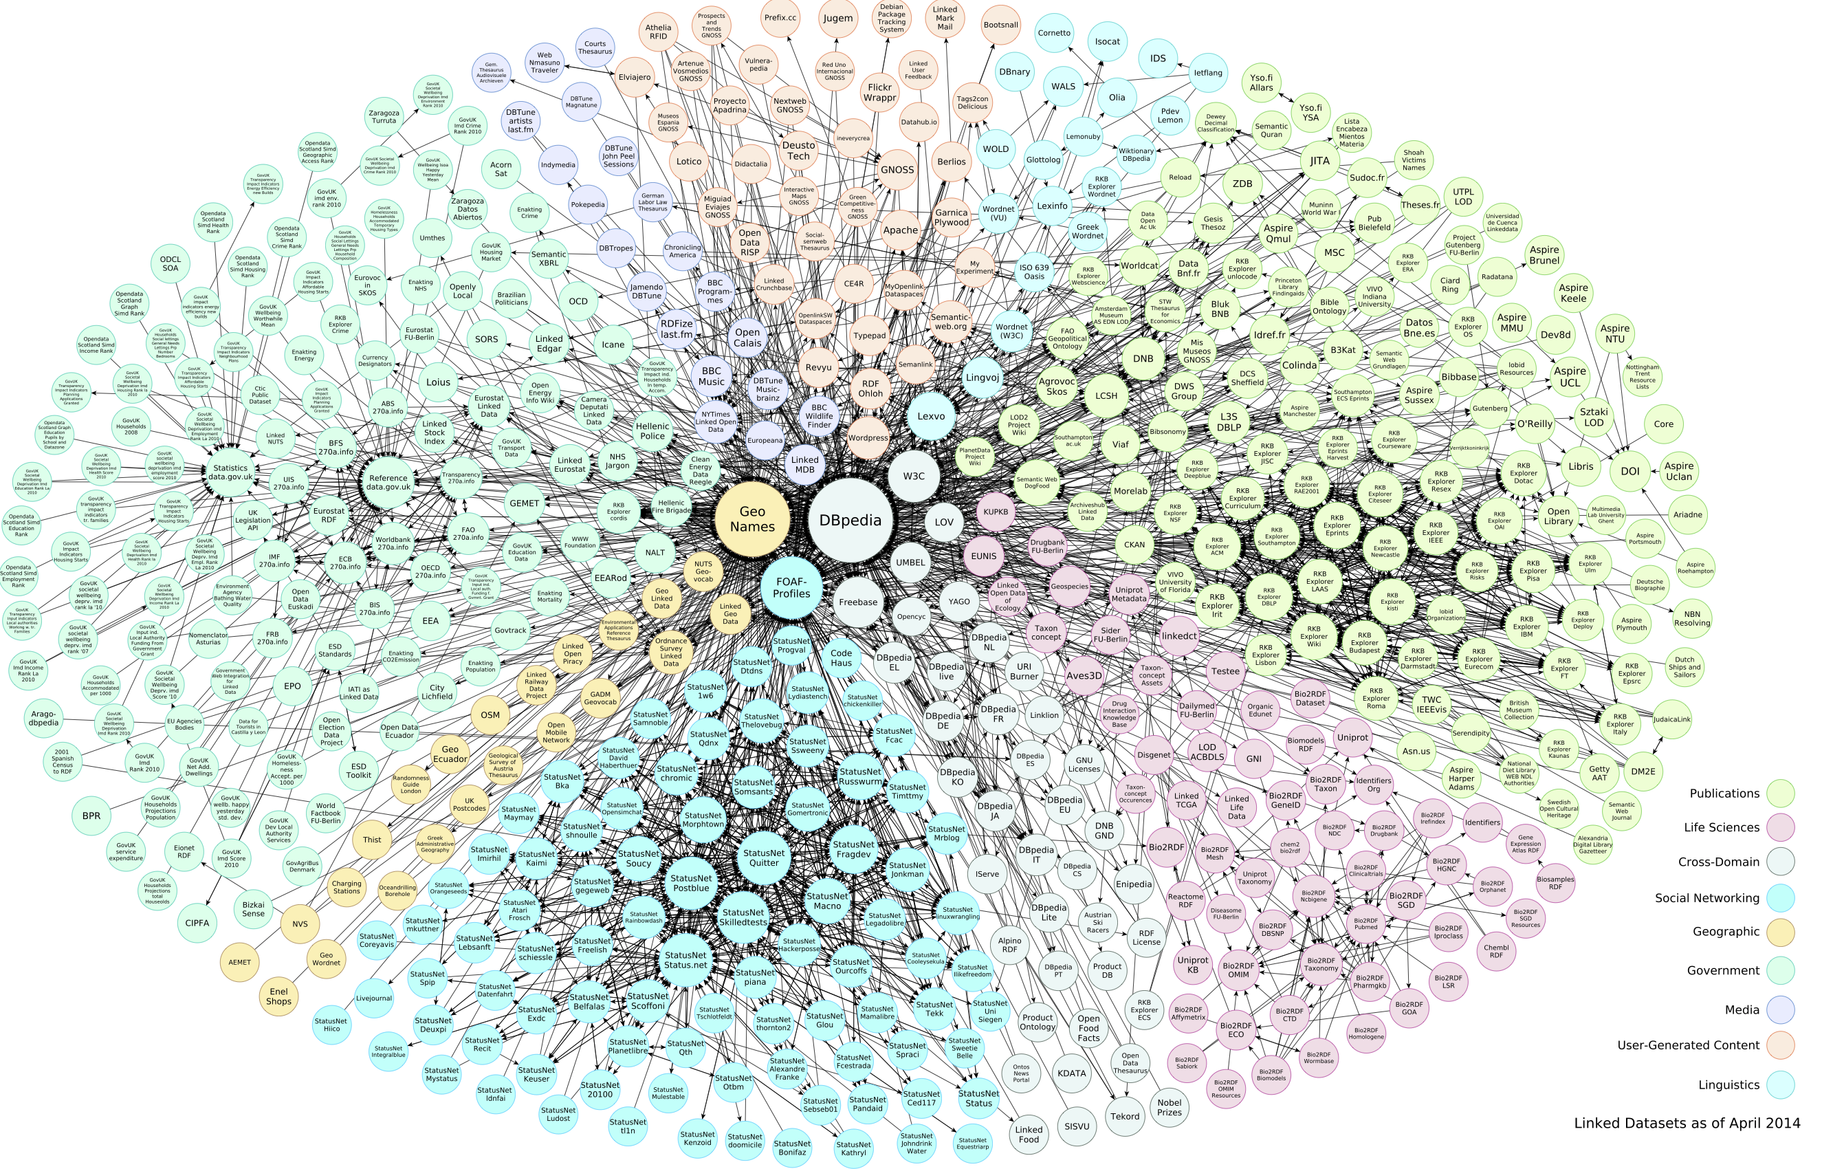
LOD Cloud
LOD Cloud is a mine of data
The heterogeneity of sources reflect directly on the data quality
Finding useful dataset without prior knowledge is increasingly difficult
Demonstrate the of LOD Cloud metadata by running Roomba on the accessible LOD Cloud through datahub.io
What's up LOD Cloud - Observing The State of Linked Open Data Cloud Metadata
Notes:
The 259 datasets contain a total of 1068 resources.

Slide 3
Dataset Metadata
Metadata is structured information that describes, explains, locates or otherwise makes it easier to retrieve use or manage information resources
Data Portals are a curated collection of datasets metadata providing a set discovery and integration services
We divided the metadata information into four main types
What's up LOD Cloud - Observing The State of Linked Open Data Cloud Metadata

Slide 4
Metadata Information Groups
Resource
Tag
Group
Organization
Actual raw data that can be downloaded or accessed directly e.g. JSON, CSV, SPARQL endpoint
Descriptive knowledge about the dataset contents and structure. This can range from simple textual tags to semantically rich controlled terms
Organizational units that share common semantics. They can be seen as a cluster or curation based on shared themes/categories
Clustering or curation solely based on associations with specific administration parties
What's up LOD Cloud - Observing The State of Linked Open Data Cloud Metadata

Slide 5
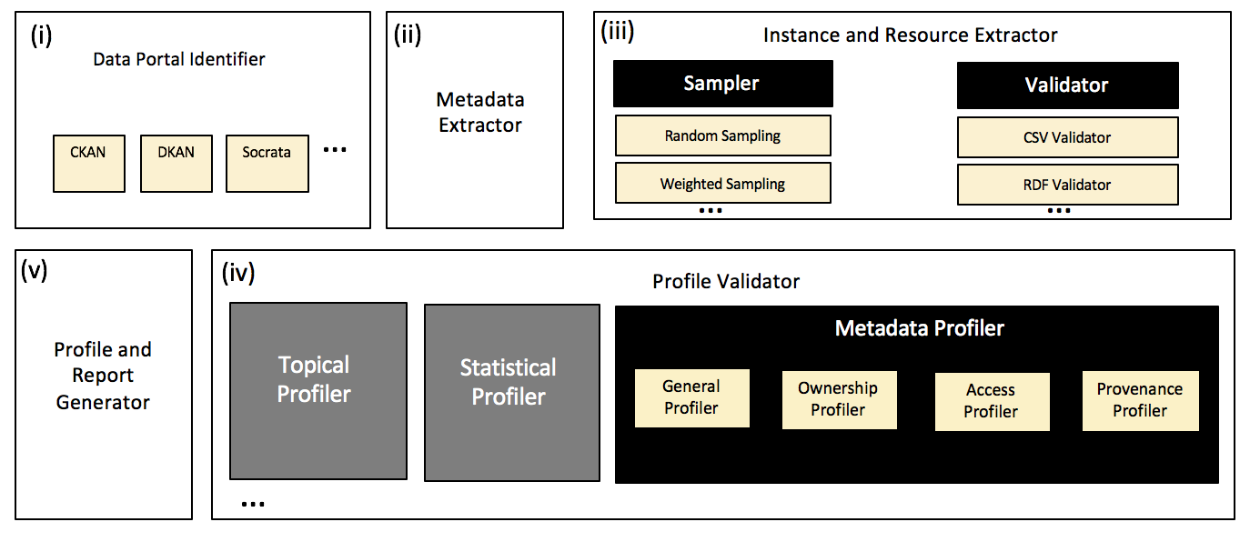
Roomba - An Extensible Framework to Validate and Build Dataset Profiles
Roomba addresses the challenges of automatic validation and generation of descriptive dataset profiles
https://github.com/ahmadassaf/opendata-checker/
What's up LOD Cloud - Observing The State of Linked Open Data Cloud Metadata

Slide 7
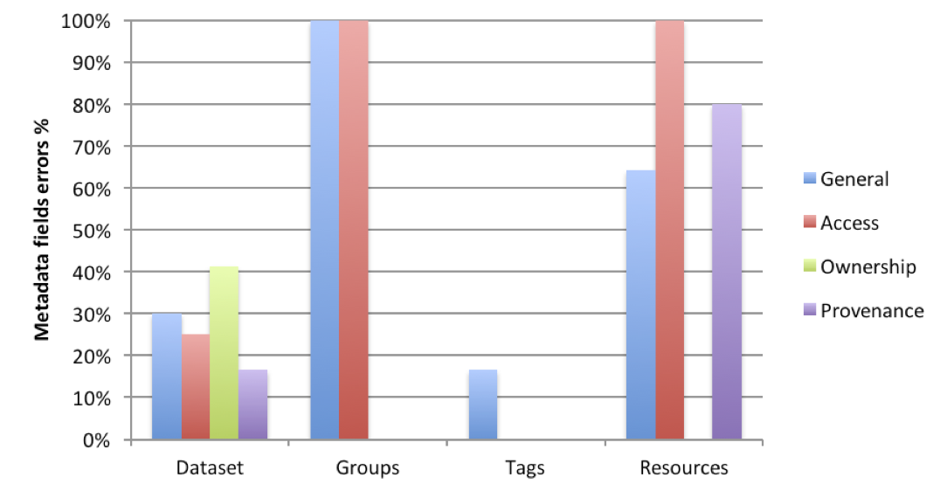
Metadata Errors for Information Groups
41% of ownership information is missing or undefined
Resources have the poorest metadata health across information groups
64% general metadata
100% access metadata
80% provenance metadata
What's up LOD Cloud - Observing The State of Linked Open Data Cloud Metadata

Slide 8
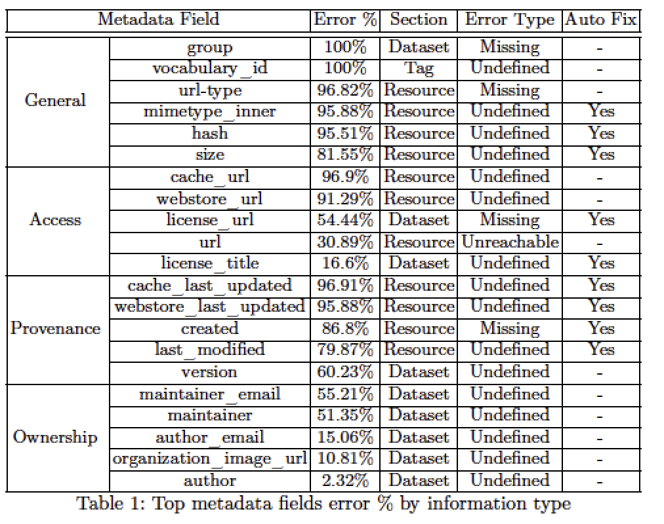
Top Metadata Errors
23.8% of these errors can be fixed automatically
33.33% can be fixed automatically by tools plugged into the data publishing workflow
What's up LOD Cloud - Observing The State of Linked Open Data Cloud Metadata

Slide 9
Metadata Errors
What's up LOD Cloud - Observing The State of Linked Open Data Cloud Metadata

Slide 10
Top Metadata Errors
25% of the datasets access information are not clean [unavailability mainly]
68% of the resources access data can be fixed automatically
31.27% of the resources were not reachable
63.17% of the resources don’t have valid resource_type
Creating an aggregate report for resources > format:title
62.16% of the datasets have defined SPARQL endpoints using the api/sparql resource_format
92.27% provided RDF example links
56.3% provided direct links to downloadable RDF dumps
What's up LOD Cloud - Observing The State of Linked Open Data Cloud Metadata

Slide 11
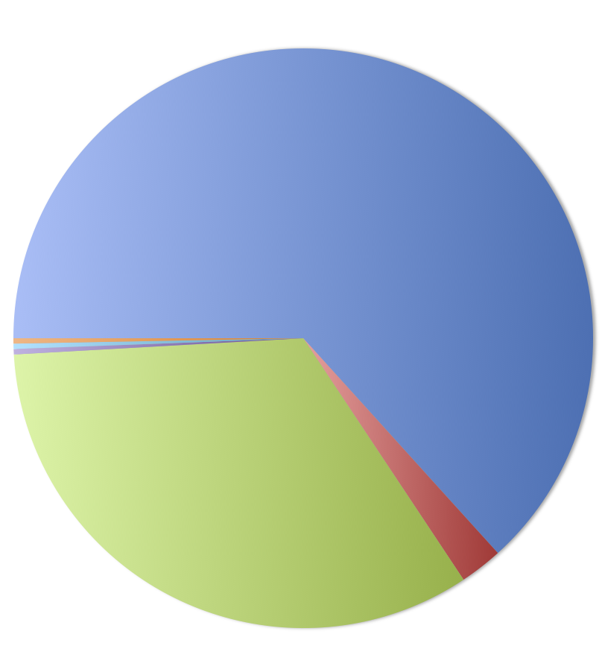
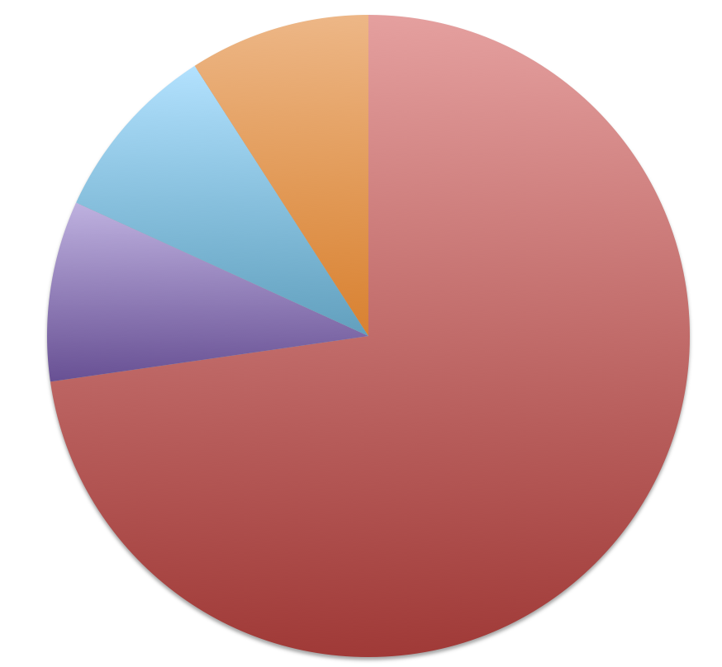
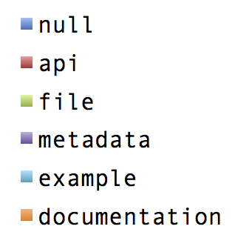
Metadata File Types Errors
What's up LOD Cloud - Observing The State of Linked Open Data Cloud Metadata
Notes:
211 (63.17%) resources do not have valid resource_type , 112 (33.53%) are files,
8 (2.39%) a re metadata and one (0.029%) are example and documentation types

Slide 12
Top Metadata Errors
25% of the datasets access information are not clean [unavailability mainly]
68% of the resources access data can be fixed automatically
31.27% of the resources were not reachable
63.17% of the resources don’t have valid resource_type
Creating an aggregate report for resources > format:title
62.16% of the datasets have defined SPARQL endpoints using the api/sparql resource_format
92.27% provided RDF example links
56.3% provided direct links to downloadable RDF dumps
What's up LOD Cloud - Observing The State of Linked Open Data Cloud Metadata

Slide 13
Metadata Errors
Noisiest part of the access metadata is license information
16.6% of the datasets don’t have license_title and license_id
54.44% datasets don’t have license_url
51.35% don’t have maintainer
55.21% of the datasets are missing maintainer_email | 15.06% author_email
80% of the provenance information is missing or undefined
The only manual field in provenance information “version” is missing from 60.23% of the datasets
What's up LOD Cloud - Observing The State of Linked Open Data Cloud Metadata

Slide 14
Enriched Profiles
1.87% of the resources have incorrect mimetype defined
4.82% of the resources have incorrect size values
47.49% of the datasets license information have been normalized via the manual license mapping file ✝
✝ https://github.com/ahmadassaf/opendata-checker/blob/master/util/licenseMappings.json
What's up LOD Cloud - Observing The State of Linked Open Data Cloud Metadata
Notes:
Roomba enhanced the access information by ~26%

Slide 15
Questions?
Ahmad Assaf
http://ahmadassaf.com
@ahmadaassaf
http://github.com/ahmadassaf
What's up LOD Cloud - Observing The State of Linked Open Data Cloud Metadata

